Slide 1
Vectors in Two Dimensions

Slide 2
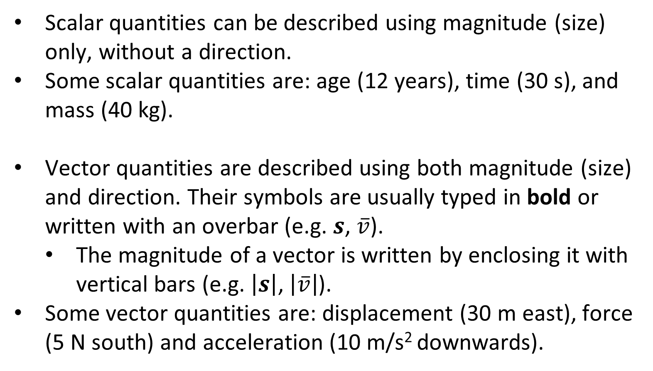
Scalars and Vectors Review
Scalar quantities can be described using magnitude (size) only, without a direction.
Some scalar quantities are: age (12 years), time (30 s), and mass (40 kg).
Vector quantities are described using both magnitude (size) and direction. Their symbols are usually typed in bold or written with an overbar (e.g. $s$, $\overline{v}$).
The magnitude of a vector is written by enclosing it with vertical bars (e.g. $\left|s\right|$, $\left|\overline{v}\right|$).
Some vector quantities are: displacement (30 m east), force (5 N south) and acceleration (10 m/s² downwards).

Slide 3

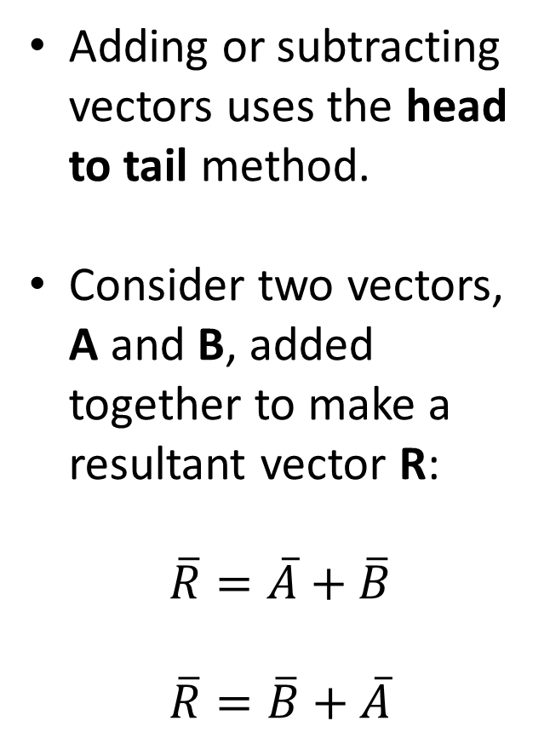






Adding Vectors
Adding or subtracting vectors uses the head to tail method.
Consider two vectors, A and B, added together to make a resultant vector R:
$$\overline{R}=\overline{A}+\overline{B}$$
$$\overline{R}=\overline{B}+\overline{A}$$
$$\overline{A}$$
$$\overline{B}$$
$$\overline{A}$$
$$\overline{R}$$
$$\overline{A}$$
$$\overline{B}$$
$$\overline{B}$$
Notes:
This is known as the commutative property of vector addition.

Slide 4

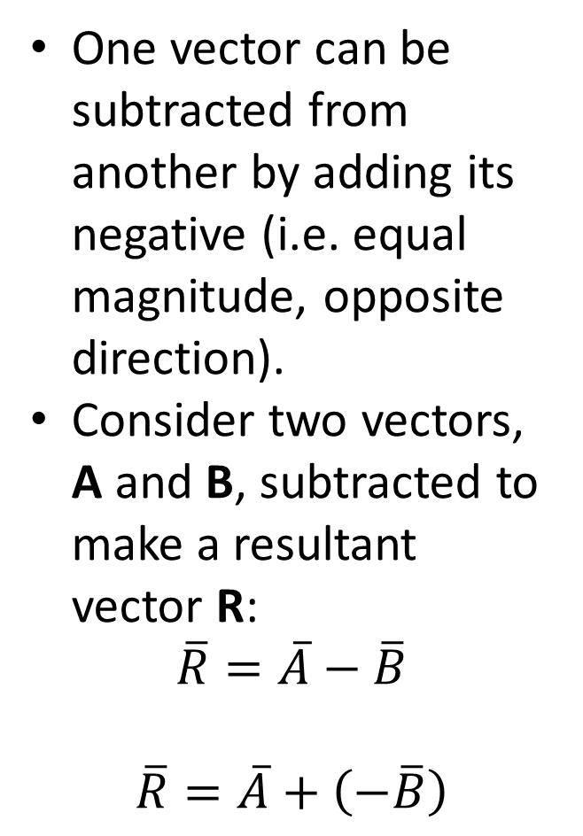




Subtracting Vectors
One vector can be subtracted from another by adding its negative (i.e. equal magnitude, opposite direction).
Consider two vectors, A and B, subtracted to make a resultant vector R:
$$\overline{R}=\overline{A}−\overline{B}$$
$$\overline{R}=\overline{A}+\left(−\overline{B}\right)$$
$$\overline{A}$$
$$\overline{A}$$
$$−\overline{B}$$
$$\overline{R}$$
$$\overline{B}$$
$$−\overline{B}$$

Slide 5


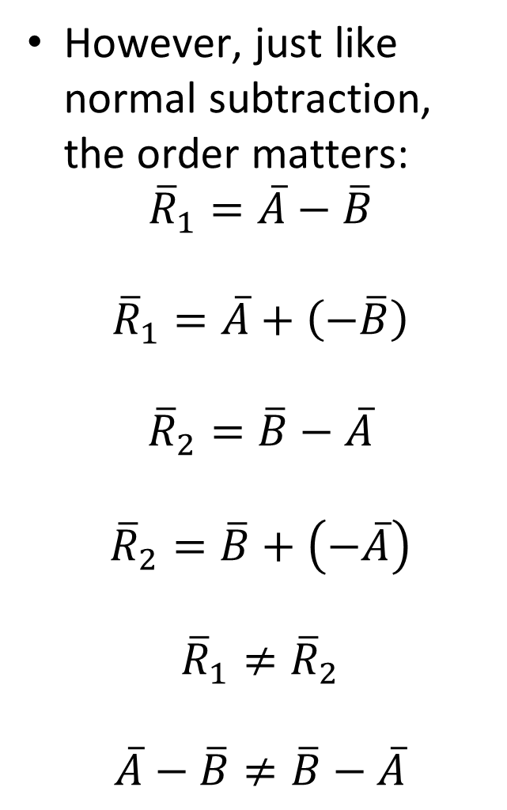





Subtracting Vectors
However, just like normal subtraction, the order matters:
$${\overline{R}}_{1}=\overline{A}−\overline{B}$$
$${\overline{R}}_{1}=\overline{A}+\left(−\overline{B}\right)$$
$${\overline{R}}_{2}=\overline{B}−\overline{A}$$
$${\overline{R}}_{2}=\overline{B}+\left(−\overline{A}\right)$$
$${\overline{R}}_{1}≠{\overline{R}}_{2}$$
$$\overline{A}−\overline{B}≠\overline{B}−\overline{A}$$
$$\overline{A}$$
$$−\overline{A}$$
$$\overline{A}$$
$$−\overline{B}$$
$${\overline{R}}_{1}$$
$$\overline{B}$$
$$−\overline{A}$$
$$\overline{B}$$
$$−\overline{B}$$
$${\overline{R}}_{2}$$
Notes:
Vector subtraction is non-commutative.

Slide 6



Resolving Vectors
Any 2D vector can be broken into two perpendicular parts called component vectors.
In physics we are often (though not always) interested in isolating and examining the horizontal and vertical components of a vector.
This process is known as resolving the vector.
$$\overline{F}$$
$${\overline{F}}_{\text{v}}$$
$${\overline{F}}_{\text{h}}$$
Notes:
The main exception to point two is objects on slopes, which we’ll come to later.

Slide 7
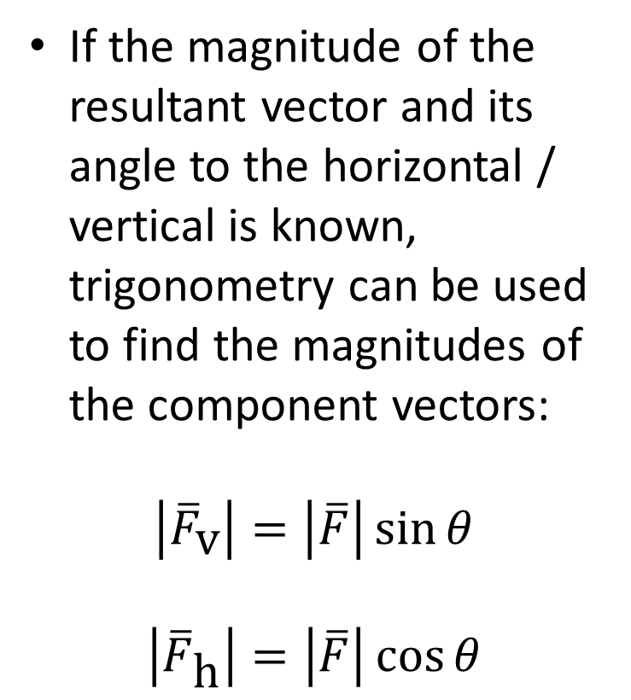

Resolving Vectors
If the magnitude of the resultant vector and its angle to the horizontal / vertical is known, trigonometry can be used to find the magnitudes of the component vectors:
$$\left|{\overline{F}}_{\text{v}}\right|=\left|\overline{F}\right|\sin{θ}$$
$$\left|{\overline{F}}_{\text{h}}\right|=\left|\overline{F}\right|\cos{θ}$$
$$\overline{F}$$
$${\overline{F}}_{\text{v}}$$
$$θ$$
$${\overline{F}}_{\text{h}}$$

Slide 8
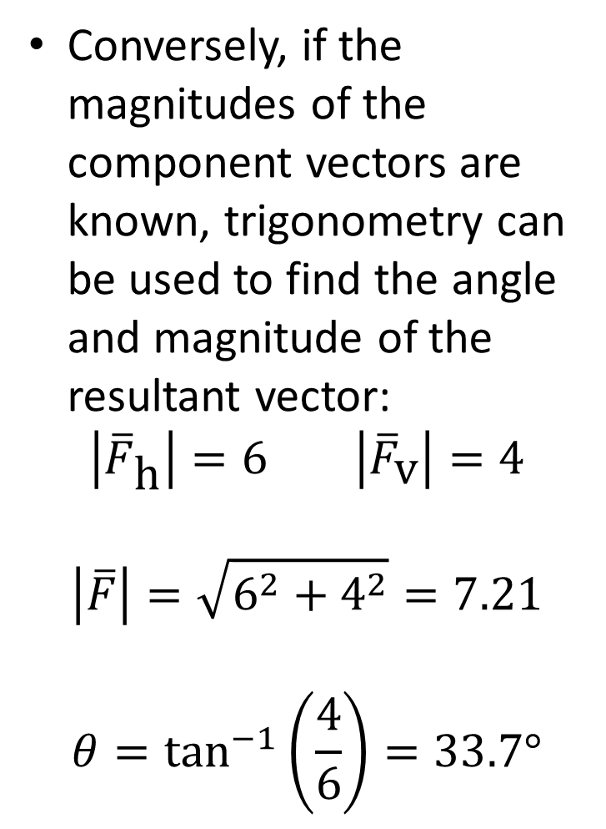
Resolving Vectors
Conversely, if the magnitudes of the component vectors are known, trigonometry can be used to find the angle and magnitude of the resultant vector:
$$\left|{\overline{F}}_{\text{h}}\right|=6 \left|{\overline{F}}_{\text{v}}\right|=4$$
$$\left|\overline{F}\right|=\sqrt{6^{2}+4^{2}}=7.21$$
$$θ=\tan^{−1}\left(\frac{4}{6}\right)=33.7°$$
$$\overline{F}$$
$${\overline{F}}_{\text{v}}$$
$$θ$$
$${\overline{F}}_{\text{h}}$$

Slide 9
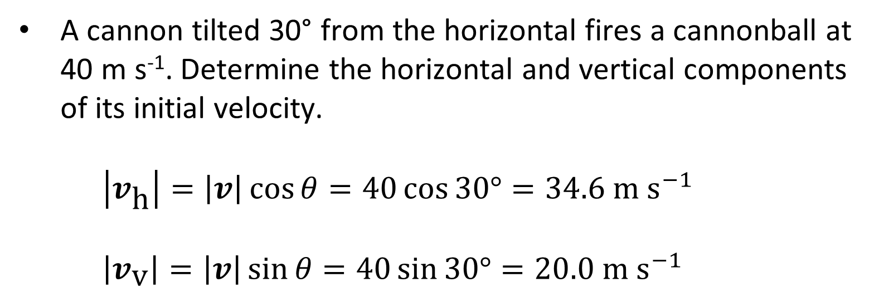




Example #1
A cannon tilted 30° from the horizontal fires a cannonball at 40 m s⁻¹. Determine the horizontal and vertical components of its initial velocity.
$\left|v_{\text{h}}\right|=\left|v\right|\cos{θ}=40\cos{30°}=34.6 \text{m} {\text{s}}^{−1}$
$\left|v_{\text{v}}\right|=\left|v\right|\sin{θ}=40\sin{30°}=20.0 \text{m} {\text{s}}^{−1}$
$$v$$
$$v_{\text{v}}$$
$$θ$$
$$v_{\text{h}}$$

Slide 10
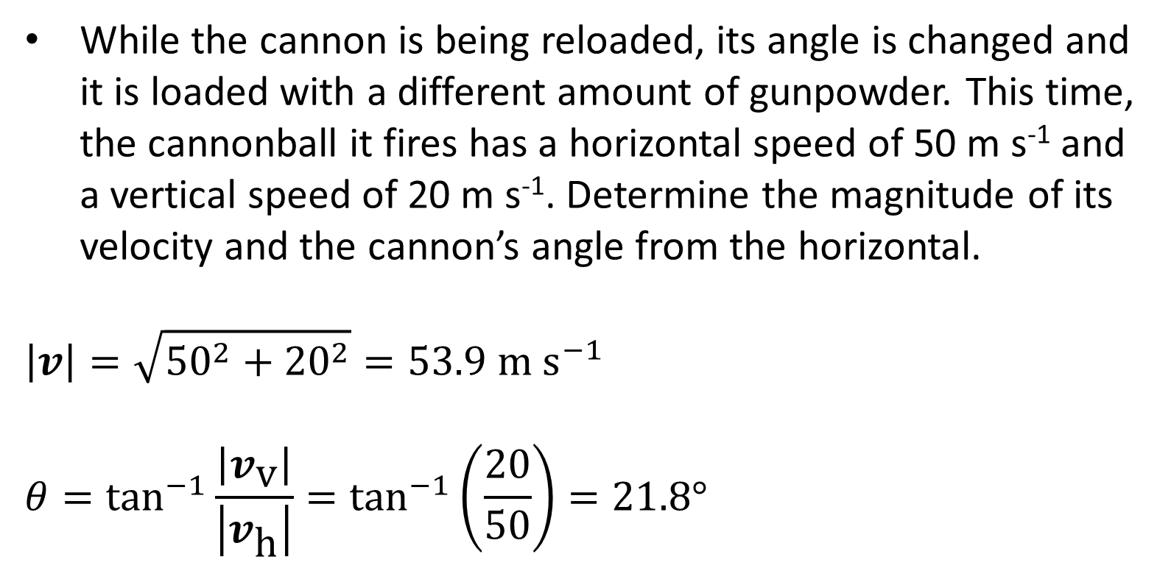



Example #2
While the cannon is being reloaded, its angle is changed and it is loaded with a different amount of gunpowder. This time, the cannonball it fires has a horizontal speed of 50 m s⁻¹ and a vertical speed of 20 m s⁻¹. Determine the magnitude of its velocity and the cannon’s angle from the horizontal.
$$\left|v\right|=\sqrt{{50}^{2}+{20}^{2}}=53.9 \text{m} {\text{s}}^{−1}$$
$$θ=\tan^{−1}{\frac{\left|v_{\text{v}}\right|}{\left|v_{\text{h}}\right|}}=\tan^{−1}\left(\frac{20}{50}\right)=21.8°$$
$$v$$
$$v_{\text{v}}$$
$$θ$$
$$v_{\text{h}}$$

Slide 11
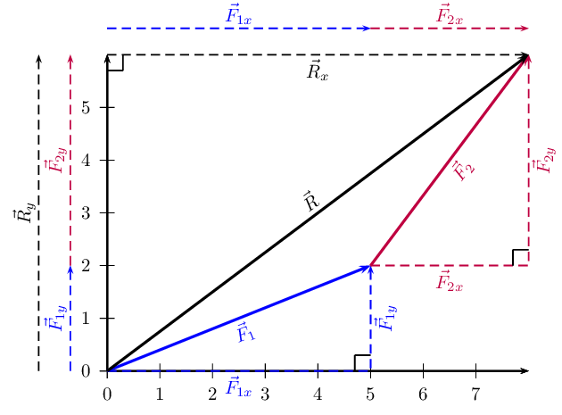
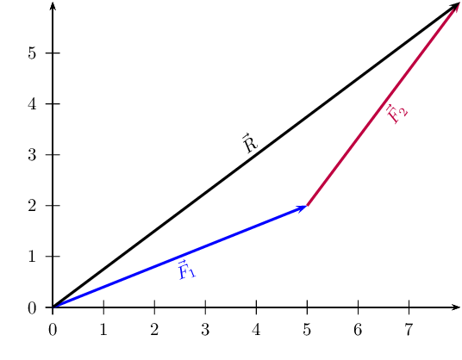
Adding Multi-Component Vectors
When adding two vectors that are not at right angles or parallel to either axis, you can split them both into their horizontal and vertical components:
However, the information required for this approach might not be provided; also, the process is inefficient and potentially confusing.

Slide 12
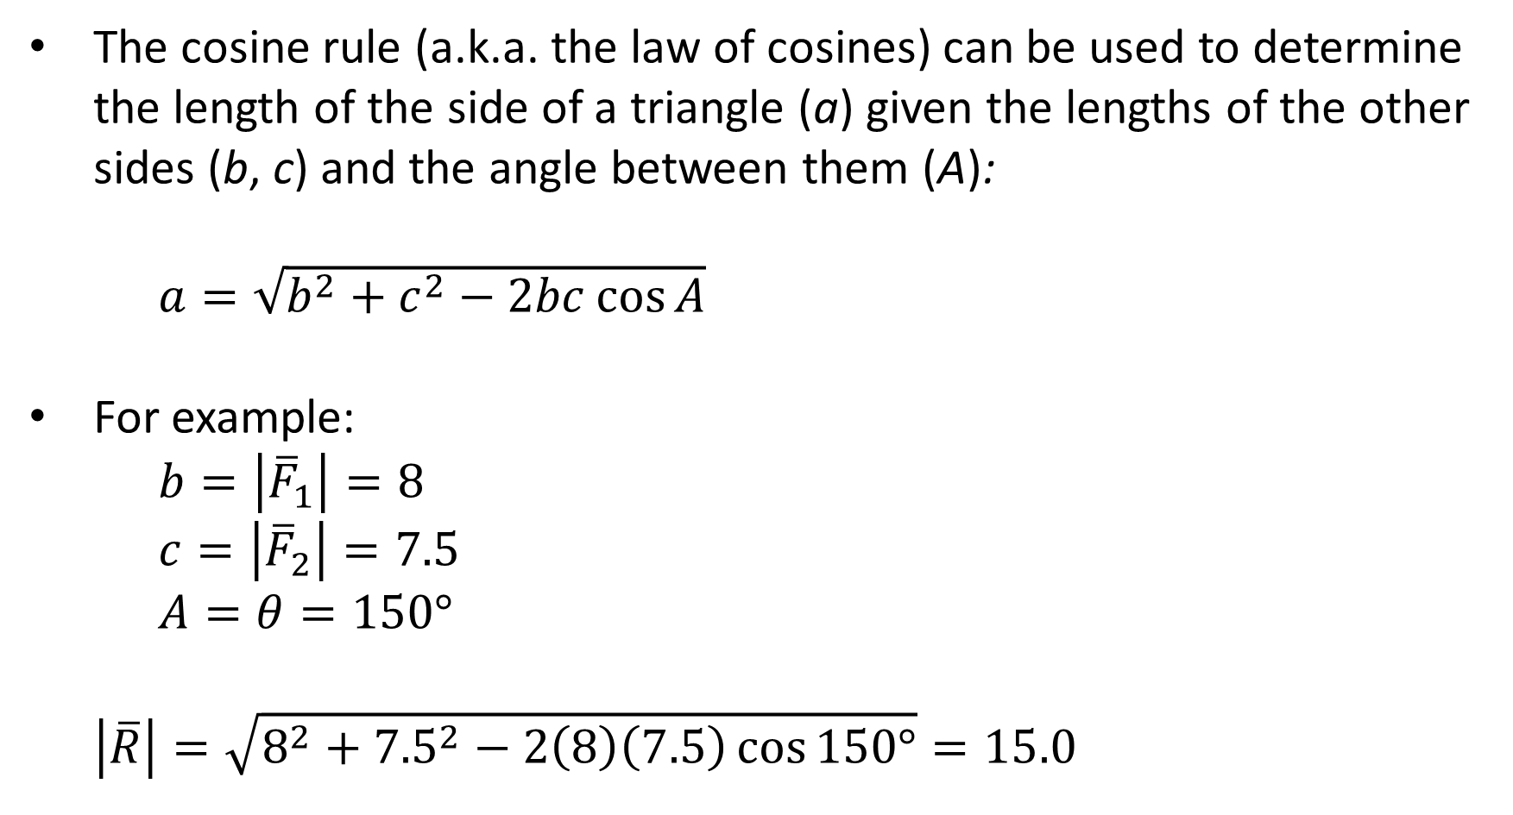

Using the Cosine Rule
The cosine rule (a.k.a. the law of cosines) can be used to determine the length of the side of a triangle (a) given the lengths of the other sides (b, c) and the angle between them (A):
$a=\sqrt{b^{2}+c^{2}−2bc\cos{A}}$
For example:
$b=\left|{\overline{F}}_{1}\right|=8$
$c=\left|{\overline{F}}_{2}\right|=7.5$
$A=θ=150°$
$$\left|\overline{R}\right|=\sqrt{8^{2}+{7.5}^{2}−2\left(8\right)\left(7.5\right)\cos{150°}}=15.0$$
$$θ$$

Slide 13

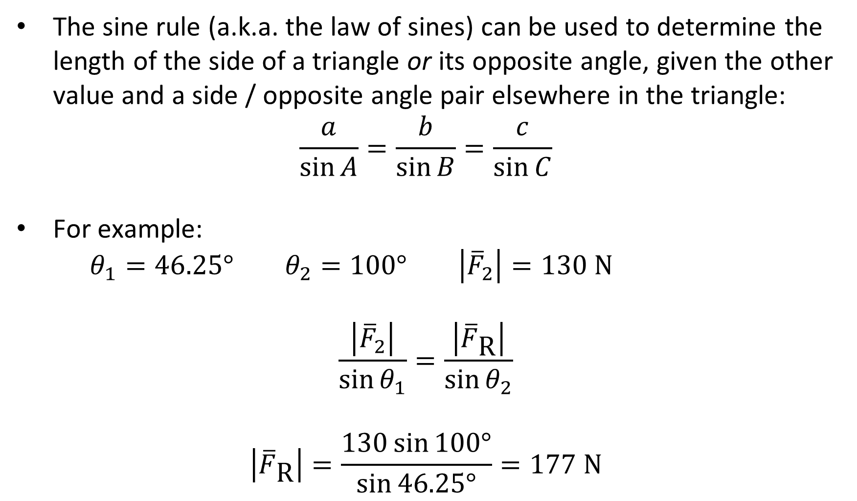




Using the Sine Rule
The sine rule (a.k.a. the law of sines) can be used to determine the length of the side of a triangle or its opposite angle, given the other value and a side / opposite angle pair elsewhere in the triangle:
$$\frac{a}{\sin{A}}=\frac{b}{\sin{B}}=\frac{c}{\sin{C}}$$
For example:
$θ_{1}=46.25° θ_{2}=100° \left|{\overline{F}}_{2}\right|=130 \text{N}$
$$\frac{\left|{\overline{F}}_{2}\right|}{\sin{θ_{1}}}=\frac{\left|{\overline{F}}_{\text{R}}\right|}{\sin{θ_{2}}}$$
$$\left|{\overline{F}}_{\text{R}}\right|=\frac{130\sin{100°}}{\sin{46.25°}}=177 \text{N}$$
$${\overline{F}}_{2}$$
$$θ_{2}$$
$${\overline{F}}_{\text{R}}$$
$$θ_{1}$$
$${\overline{F}}_{1}$$

Slide 14
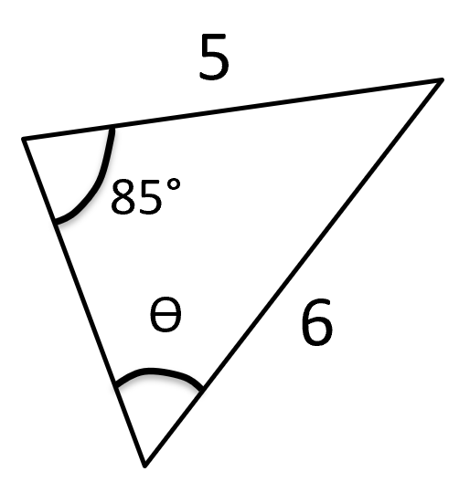

Example #3
Use the sine rule to find the value of θ.
$$\frac{a}{\sin{A}}=\frac{b}{\sin{B}}=\frac{c}{\sin{C}}$$

